Slide 1
  TuNGSTEN E-INVOICE
  SUBMISSION GUIDE

Slide 2
OBJECTIVE
To give GSK more opportunity to pay your invoice on time, we need our supplier invoices to match with the Purchase Order (PO). This document will guide you on how you check PO details, ensure your invoice matches the PO and thereby ensures matching in GSK
Improving the rate of invoices Paid on Time
Raising an e-invoice on Tungsten portal will help speed up processing as invoices are received immediately.
E-invoicing avoids postal delays of paper invoices which can be lost / sent to the incorrect place etc. Tungsten provide two methods to create an invoice in the Tungsten portal; either manually or by converting a PO into an invoice which ensures that the key fields are correct and match with Purchase Order
Key fields to ensure your invoice matches the purchase order
Unit of Measure, Line item number, GSK billing address, PO number and Currency, If all these information are correct and matched with PO, there are high probability of speedy invoice processing without any manual intervention, also ensure provided Bank account details are active correct and complete
Note – Please do not populate the GSK PO number in the “Invoice Number” field. It should be populated with your company invoice number.

Slide 3
OBJECTIVE
Below topics are covered in this deck and please follow this guidance when submit your e-invoice :
How to check PO details in Tungsten Portal
How to create e-invoice – either via PO Convert or manually enter invoice details
PO Convert is the highly recommended option to be used for e-invoice – fast, accurate with minimum efforts.
A number of improvements have been made to e-invoicing process, PO Convert Option is the new and better way’s of invoicing.
This option allows you to review, accept and automatically convert the purchase order into an invoice
Enabling faster submission and processing
Easy to manage raising invoice with just few clicks.

Slide 4
How to check PO details in Tungsten Portal

Slide 5
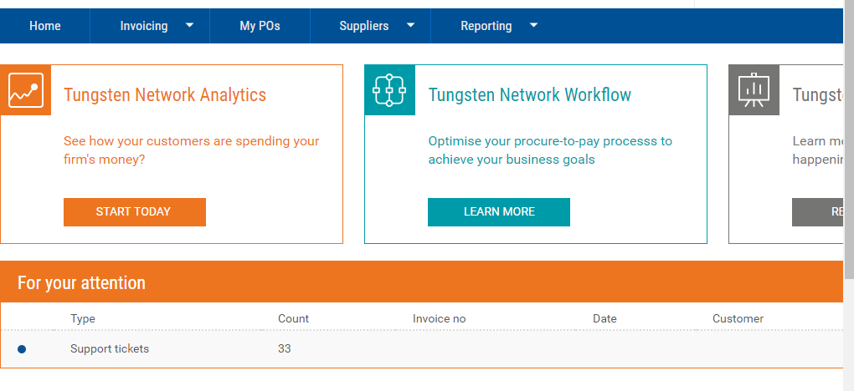
Login to Tungsten Portal and Click on My POs option

Slide 6
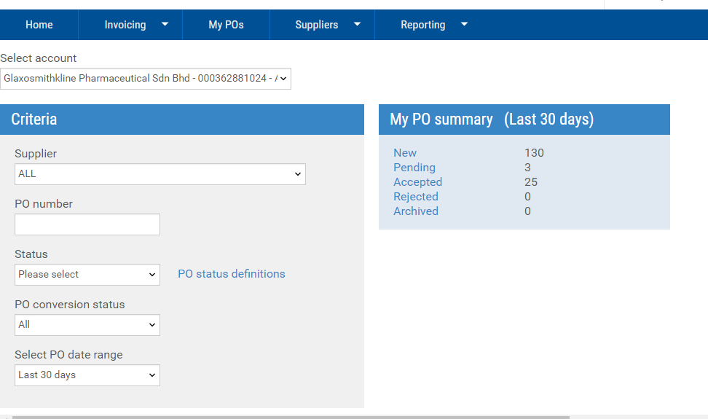
Key in respective PO number and search
Check your PO status of last 30 days
Supplier to choose the right Buyer account
http://www.tungsten-network.com/media/16602564/gsk_live_entities.xlsx

Slide 7
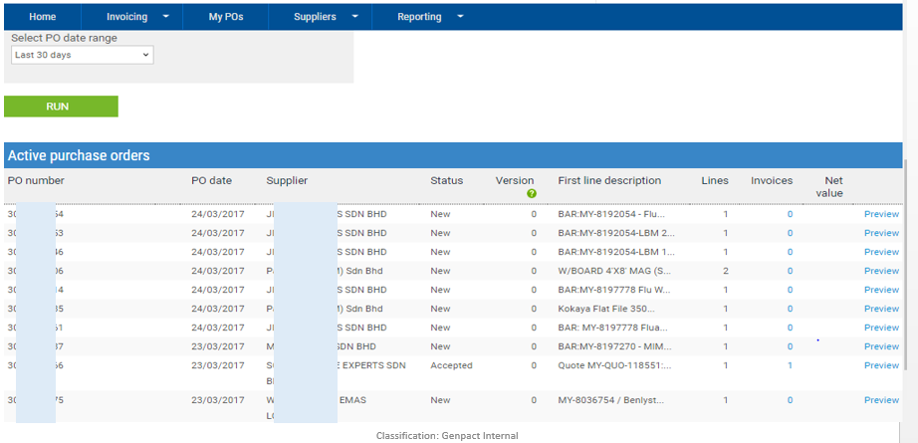
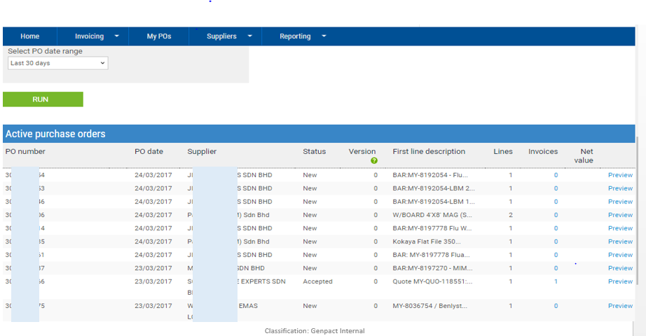
Click on Preview to display the PO details

Slide 8
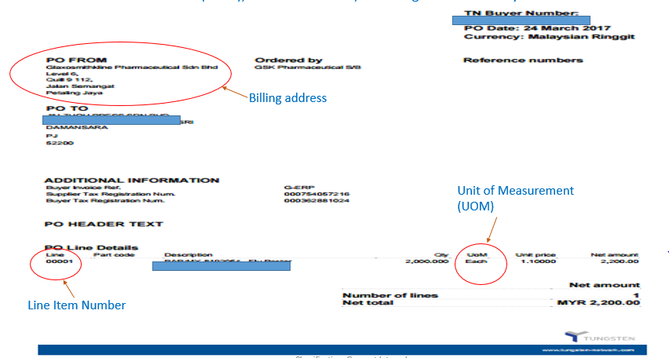
Check the PO Billing address, PO Unit of Measurement (UOM), Line item number - you should ensure the same info to be populated if you are create your E-invoice manually

Slide 9
Create E-Invoice via Convert PO feature

Slide 10
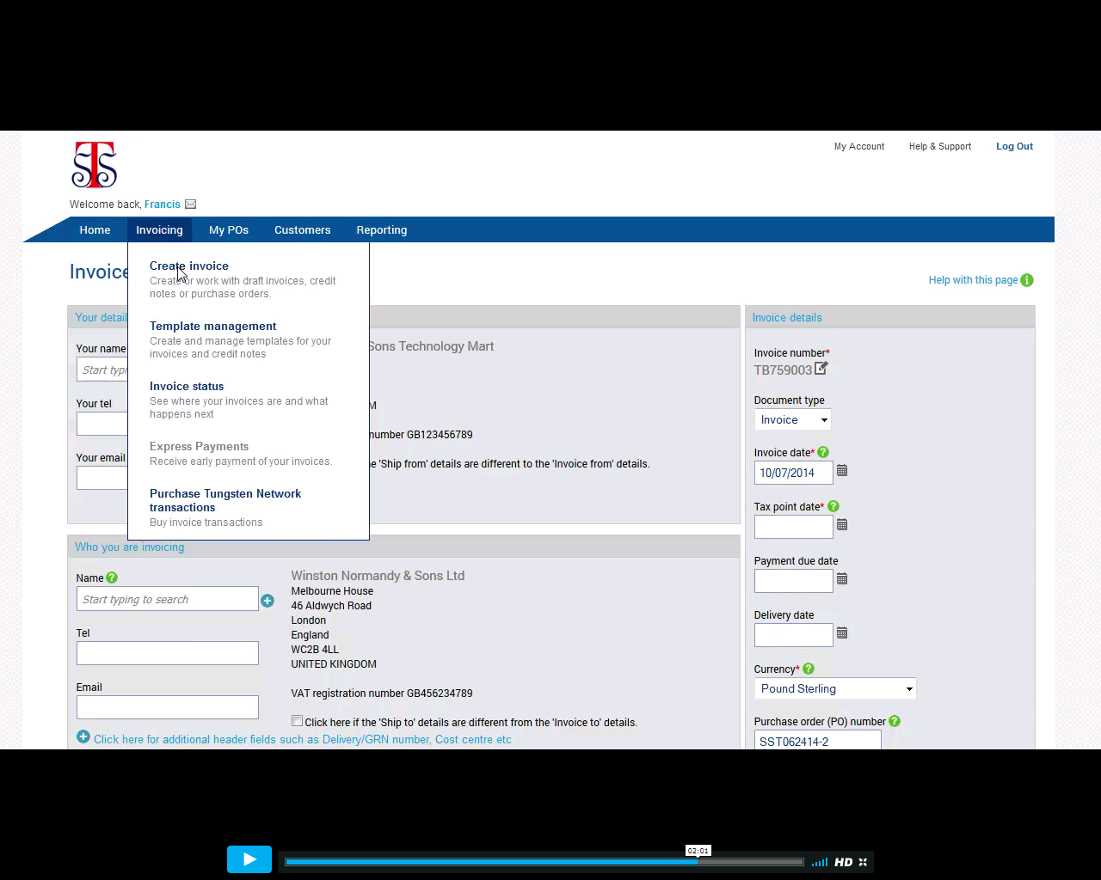
Click on create invoice

Slide 11
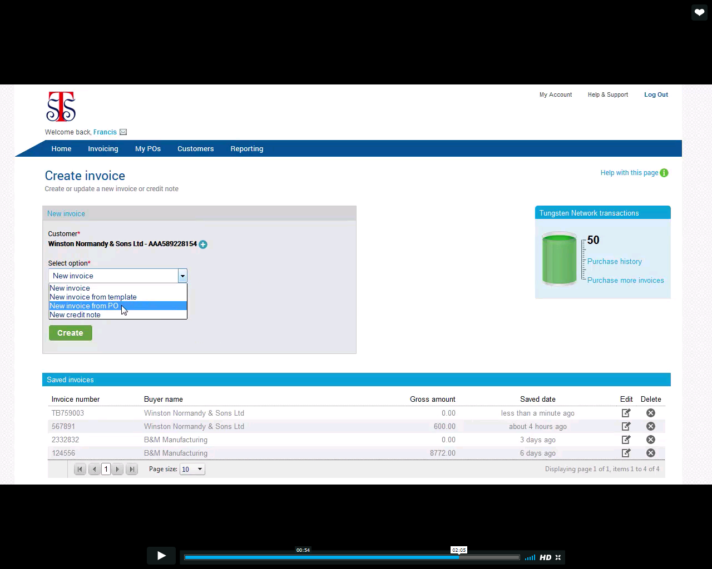
Select the option “new invoice from PO”

Slide 12
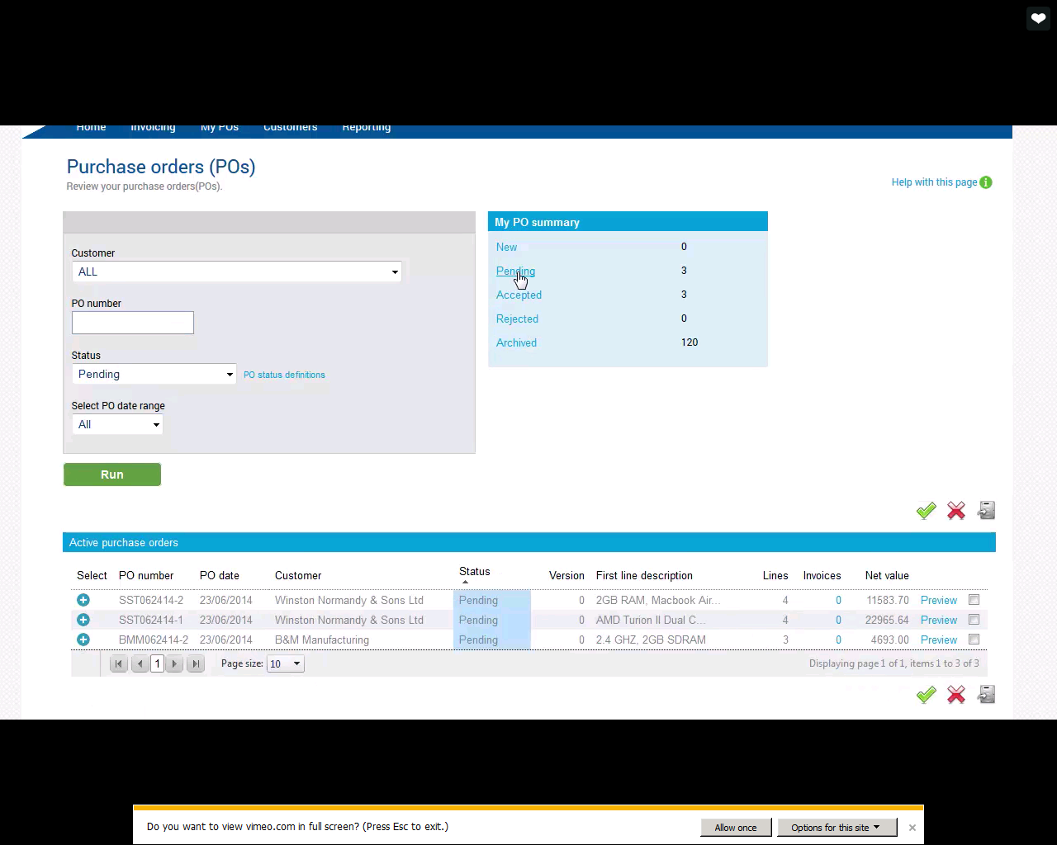
Click on the pending PO

Slide 13
Active PO will appear. Select the PO from the list at which you wish to convert it into invoice

Slide 14
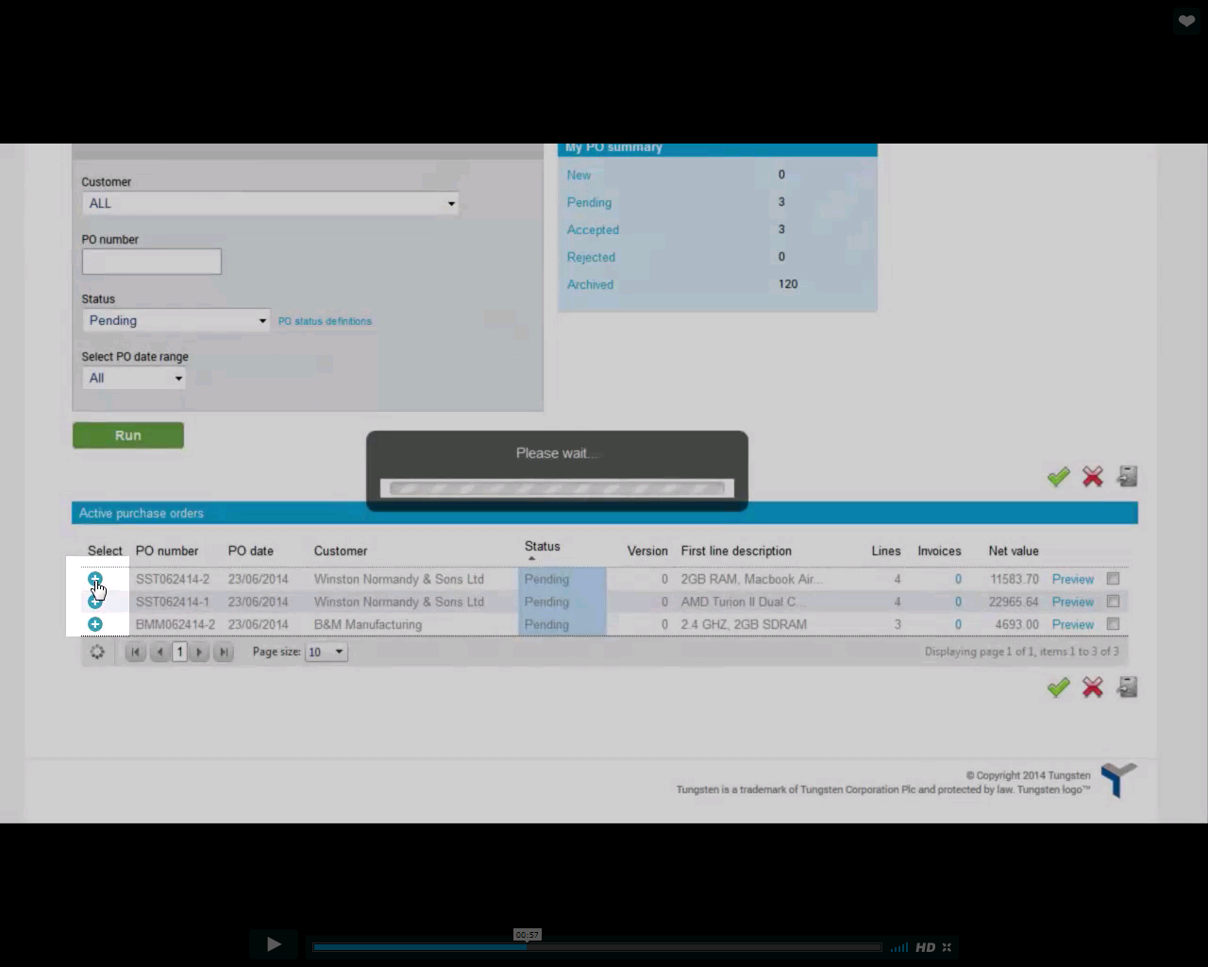
After selecting the PO, click on the positive (‘+’) blue symbol to open the PO

Slide 15
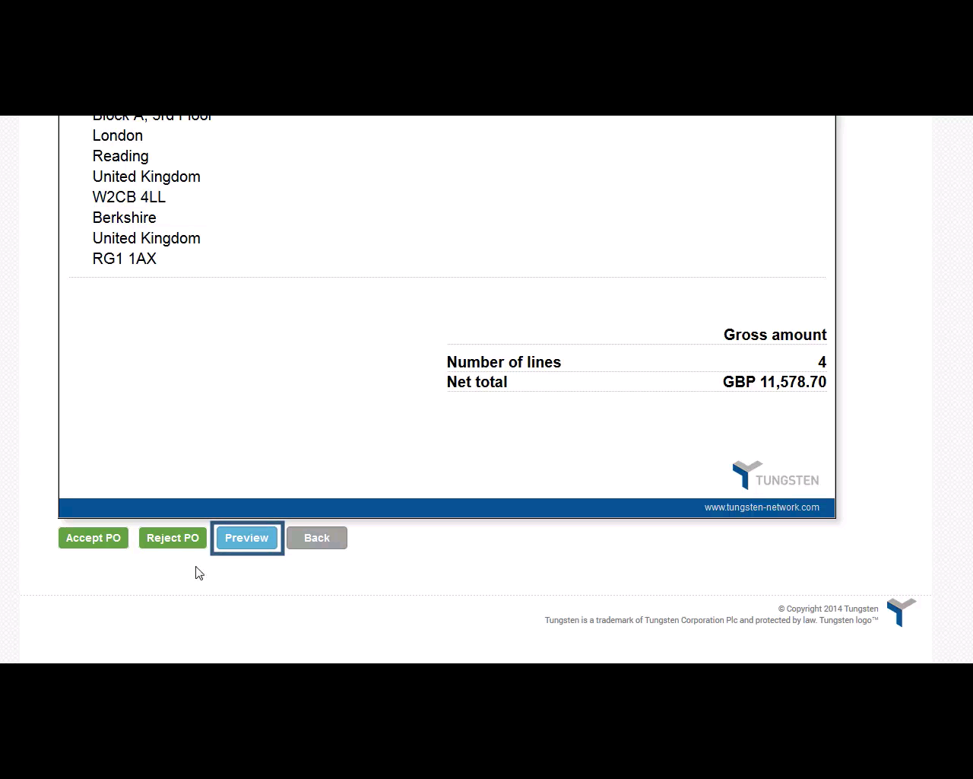
Click on preview option to see the PO preview and validate information

Slide 16
Validate PO details and Click on “Accept PO” to proceed convert this PO as invoice

Slide 17
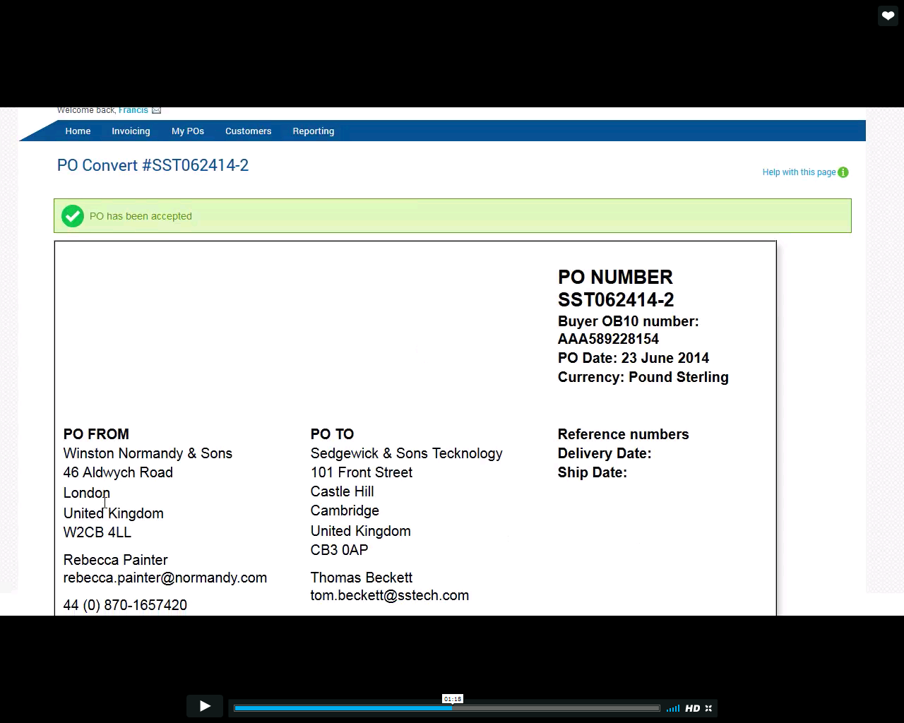
PO has been accepted

Slide 18
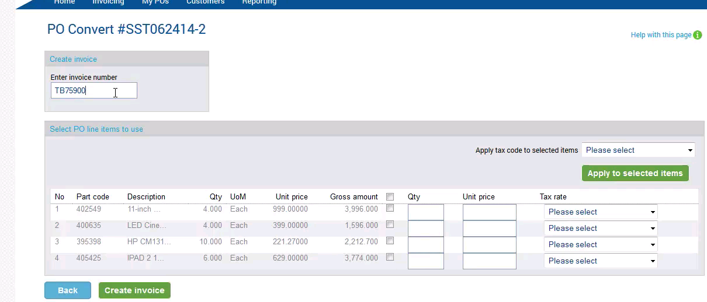
Enter the unique invoice number (this should be your company invoice number)

Slide 19
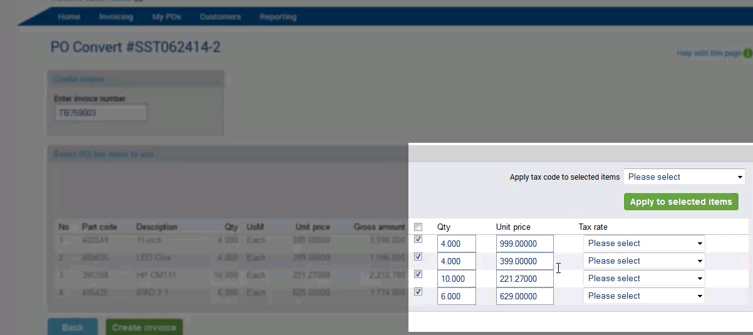
Select the line items on which invoice needs to be created

Slide 20
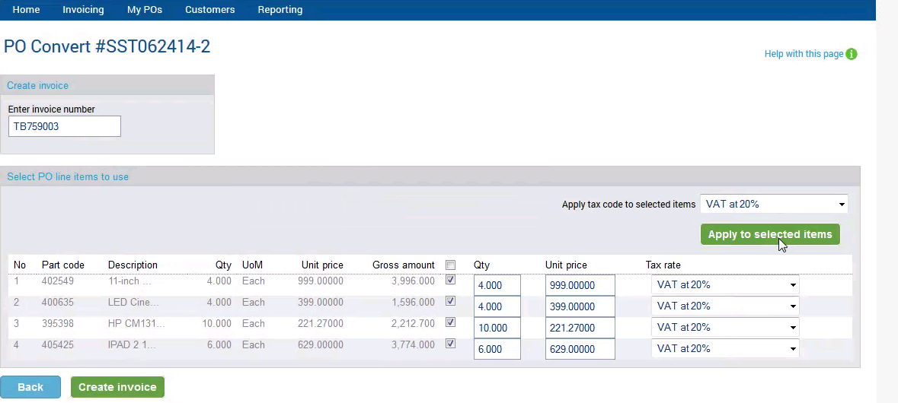
Select the tax code and click “Apply to selected items”

Slide 21
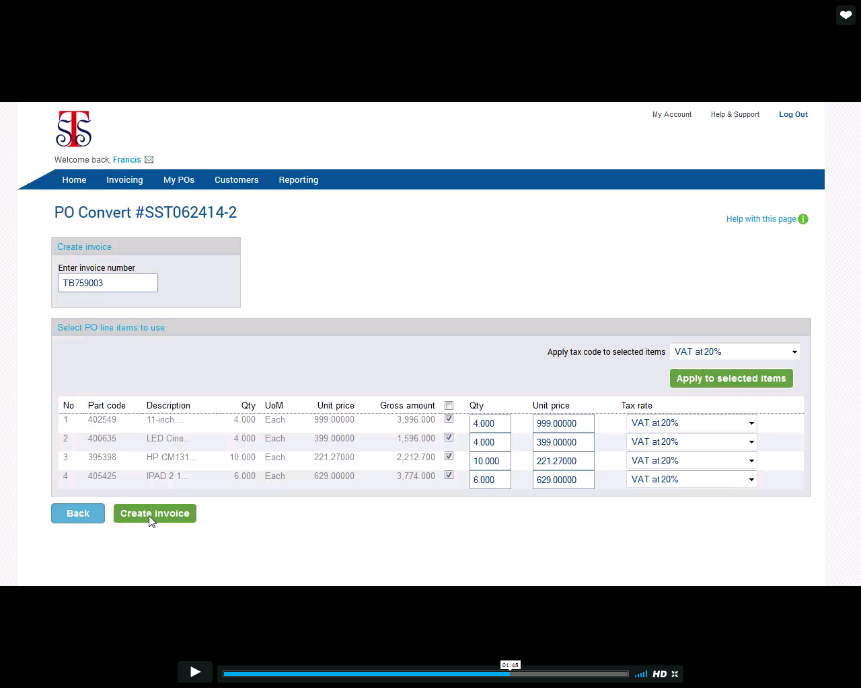
Perform final review of your invoice to ensure all billing information have been populated correctly. Click on “create invoice” to complete the step.

Slide 22
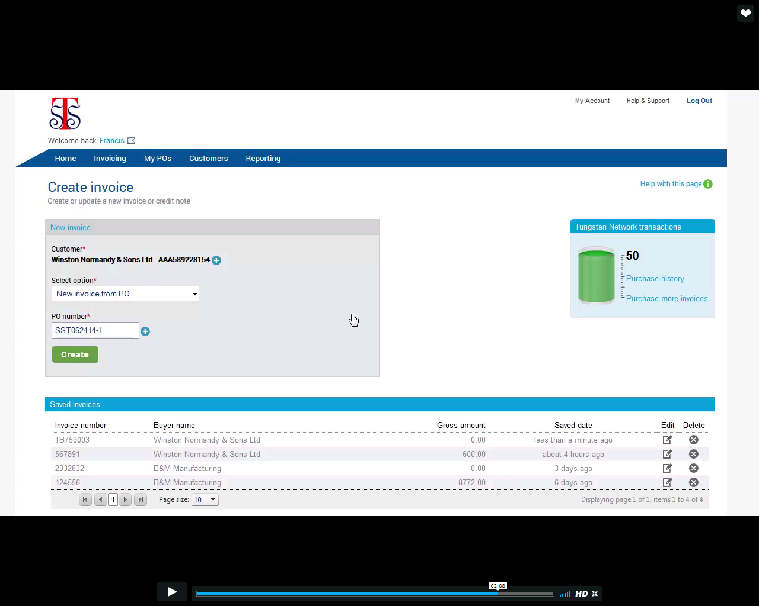
Your new invoice has been created. You may click on the respective invoice number to view it

Slide 23
Create E-Invoice via manual entering invoice details

Slide 24
Login to Tungsten Portal, Click on Invoicing

Slide 25
Click on create invoice

Slide 26
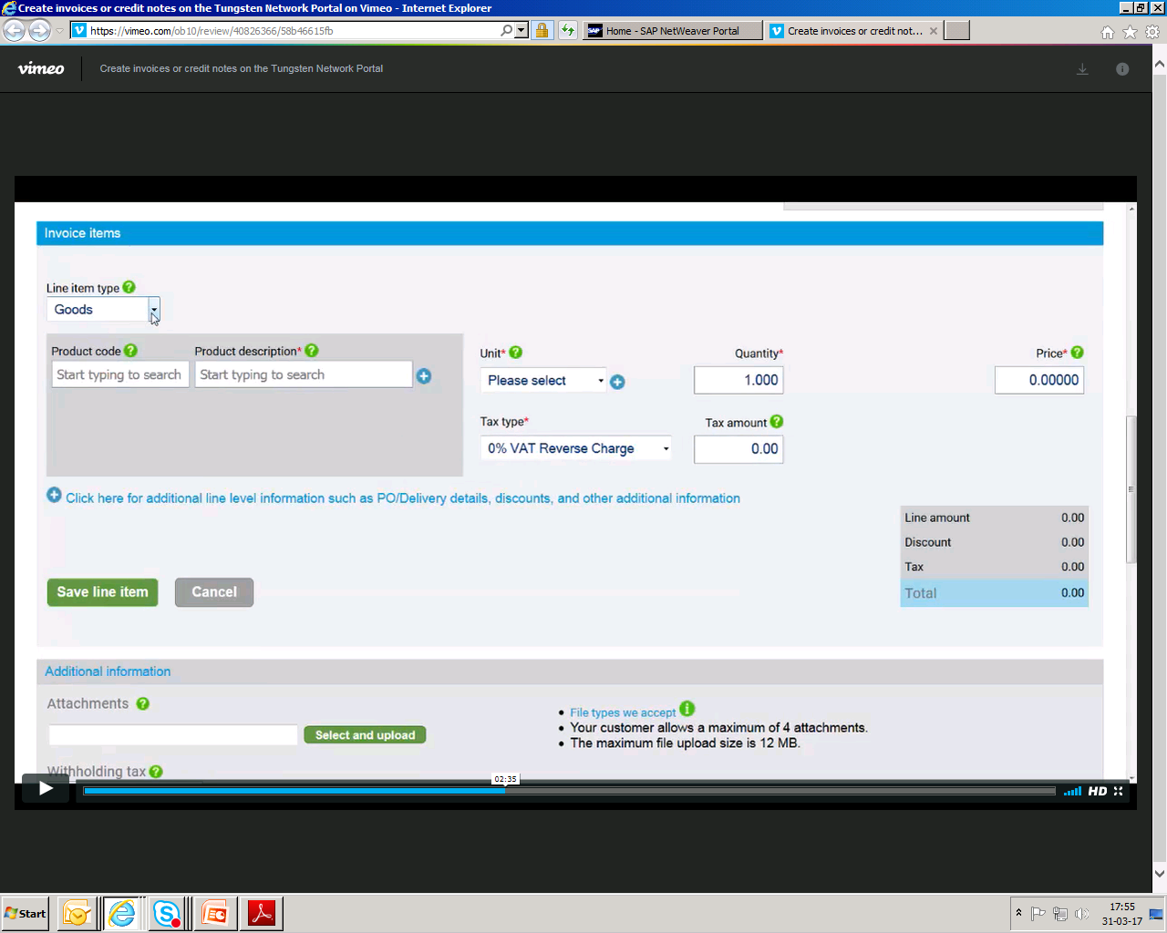
Select the Nature of billing, e.g. service/goods from the dropdown list

Slide 27
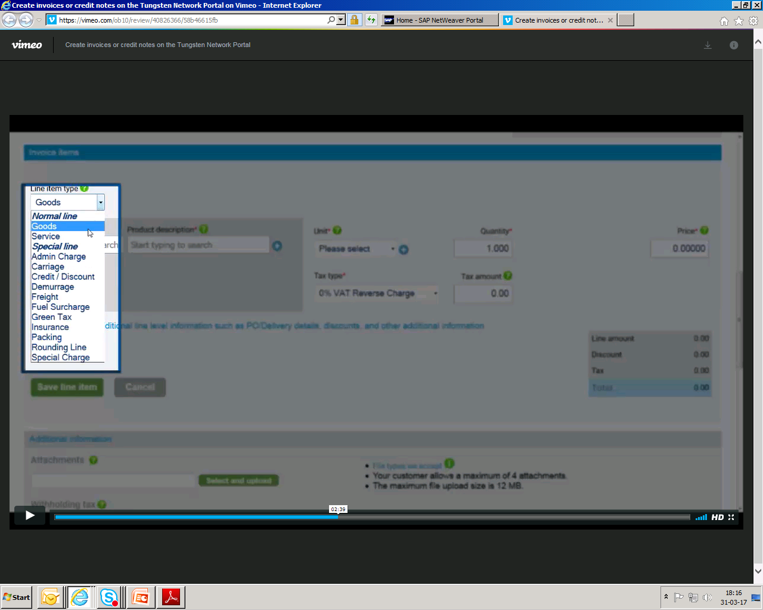
Select goods type

Slide 28
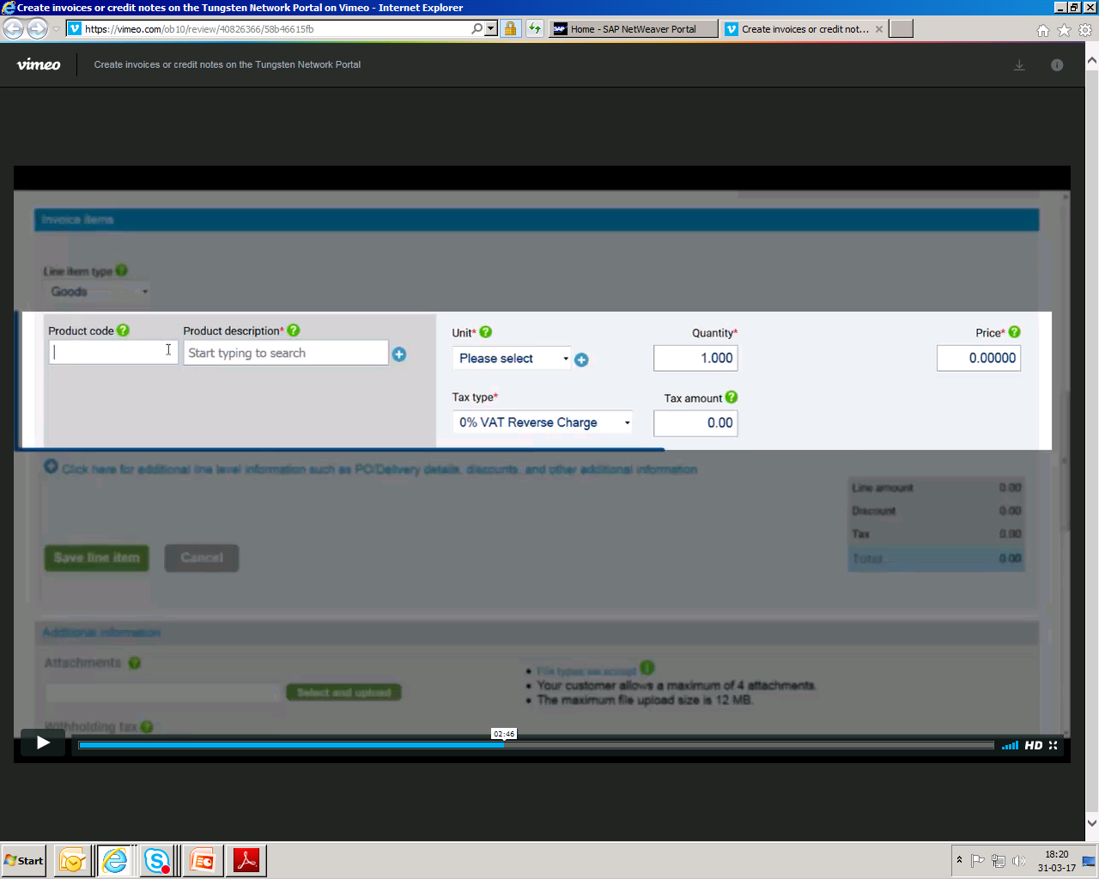
Key in Product code and Product Description.

Slide 29
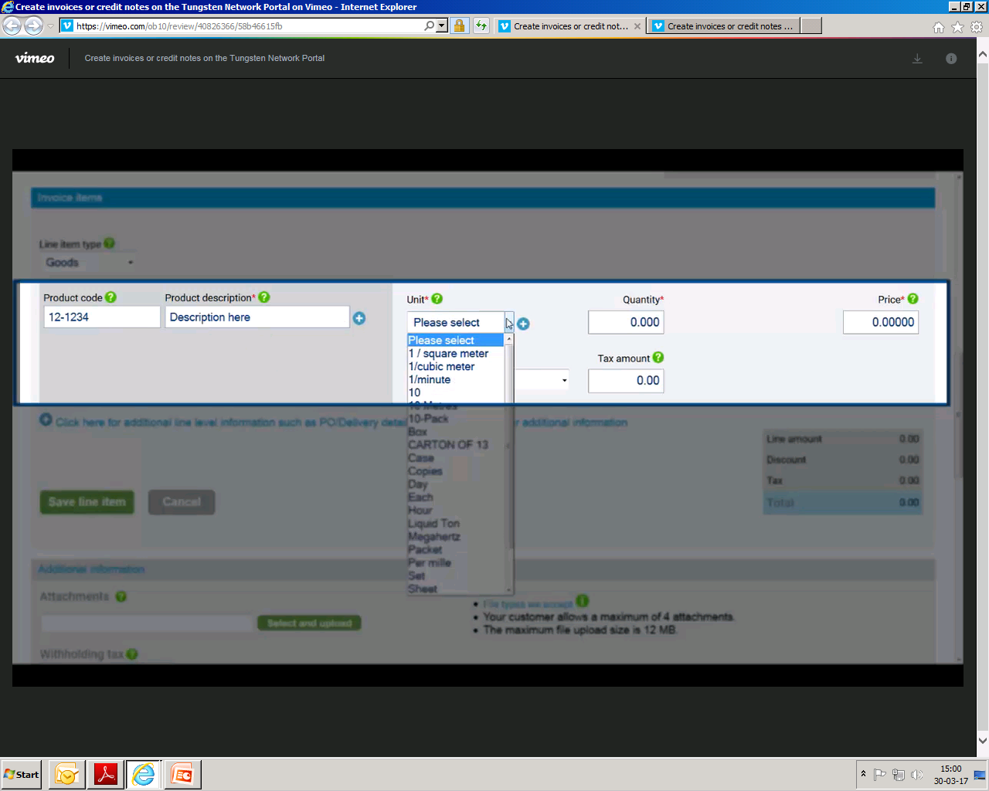
Click on the Unit drop down list and select the appropriate Unit of measurement from the list. Ensure it is the same as GSK PO

Slide 30
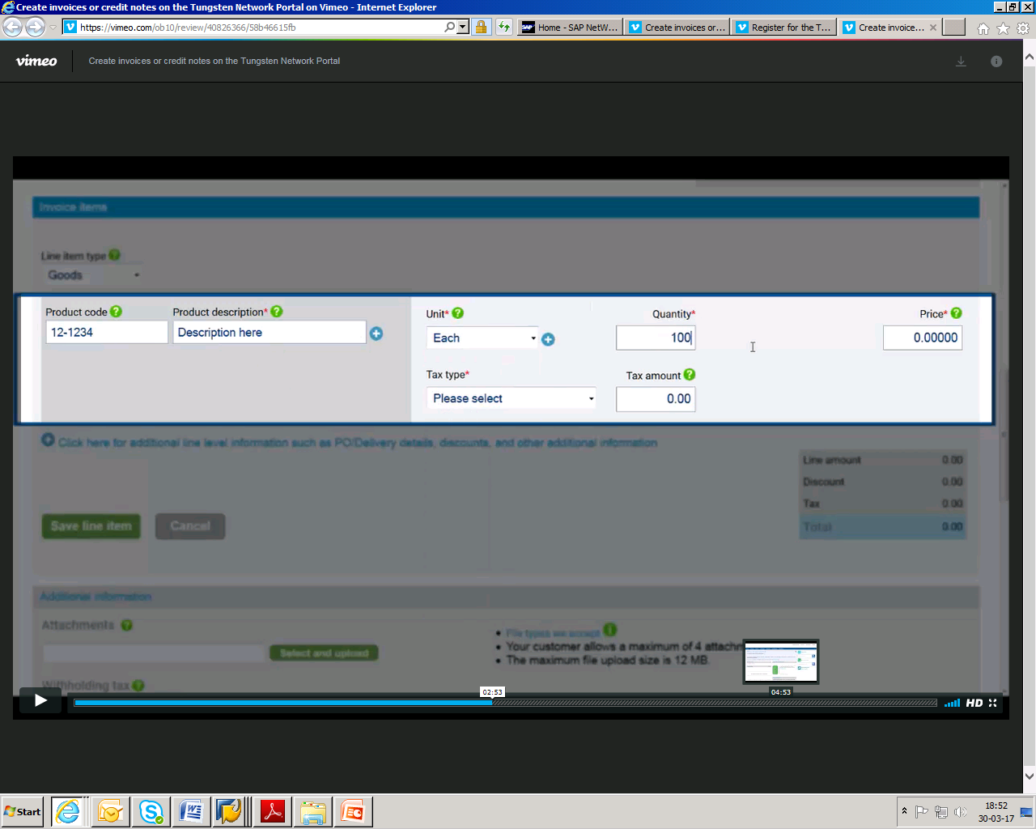
Select the correct applicable tax type

Slide 31
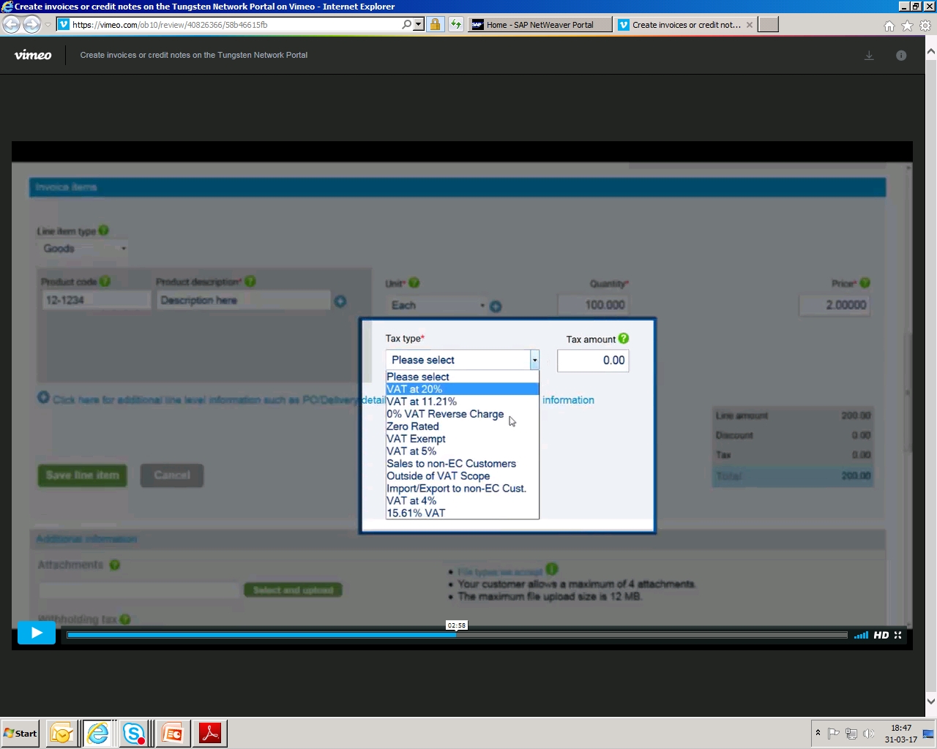
Click on Tax type drop down list and select the appropriate tax type.

Slide 32
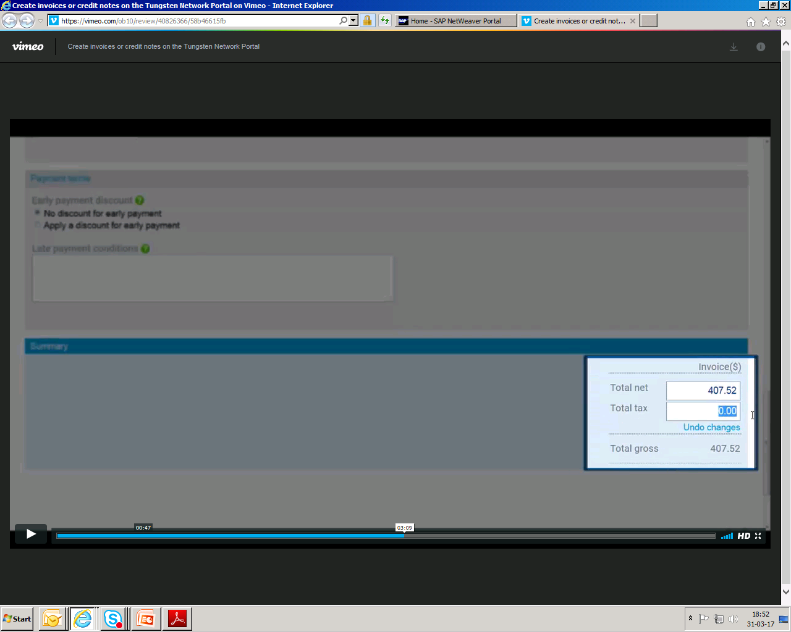
If you do not have access to enter the tax in the line level, it could due to your company tax registration number is yet to maintain in Tungsten.
Please proceed to update the tax registration as below instruction.
Process to update Tax registration number - My Account > Update company details > select “Yes” for VAT registered > Update registration number. Once completed, please refresh settings by logging out and re login. The tax details will then appear.

Slide 33
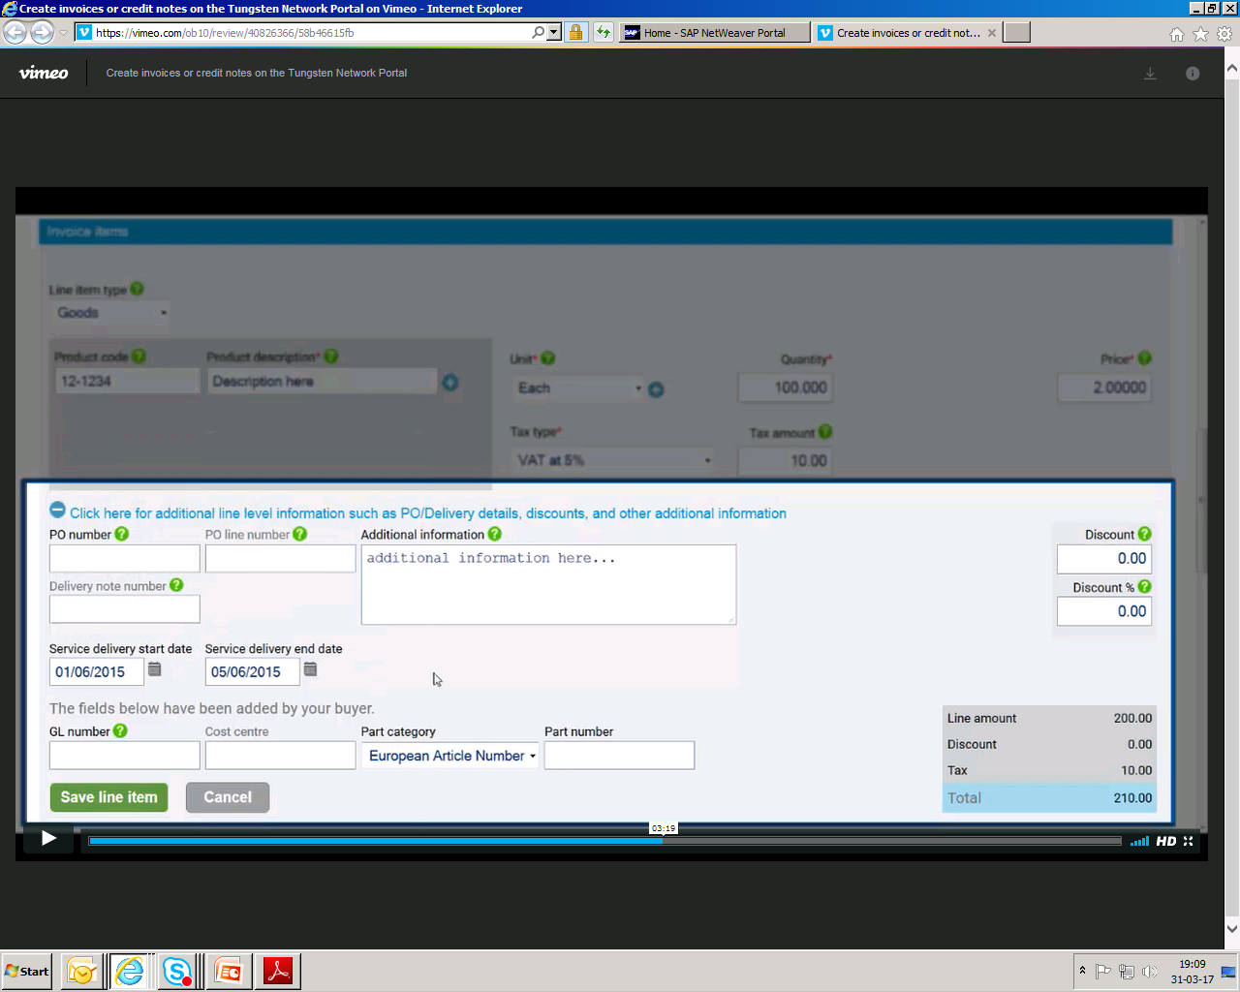
Key in line item number here. Line item number should be the same as GSK PO Line item

Slide 34
If you want to add additional line item, click on the (-) box in blue. Fill the start date, end date and other details then click ‘save line item’ .

Slide 35
Scroll down to get Remit bank details update option

Slide 36
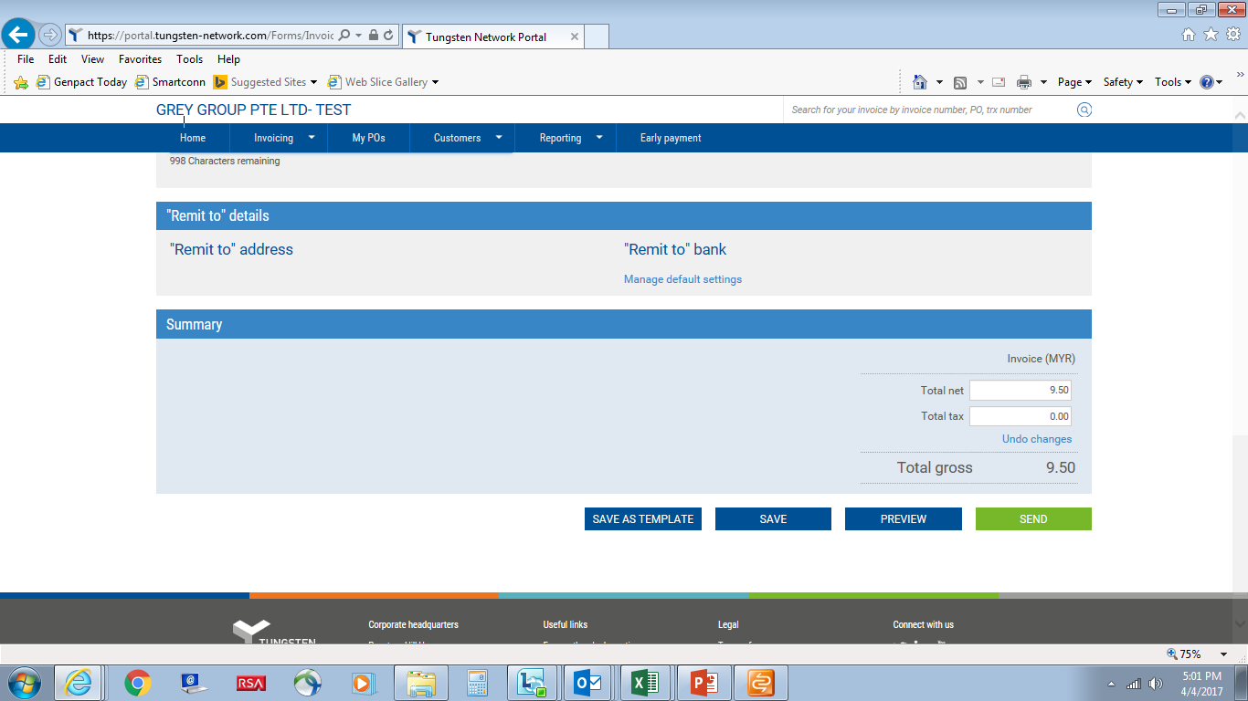
Click on ‘Manage default setting’ to update the bank details

Slide 37
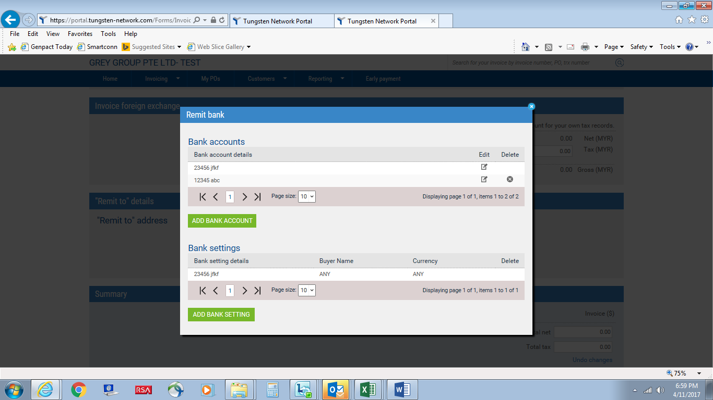
Click on ‘Add Bank Account’ if you have any new bank account number to add

Slide 38
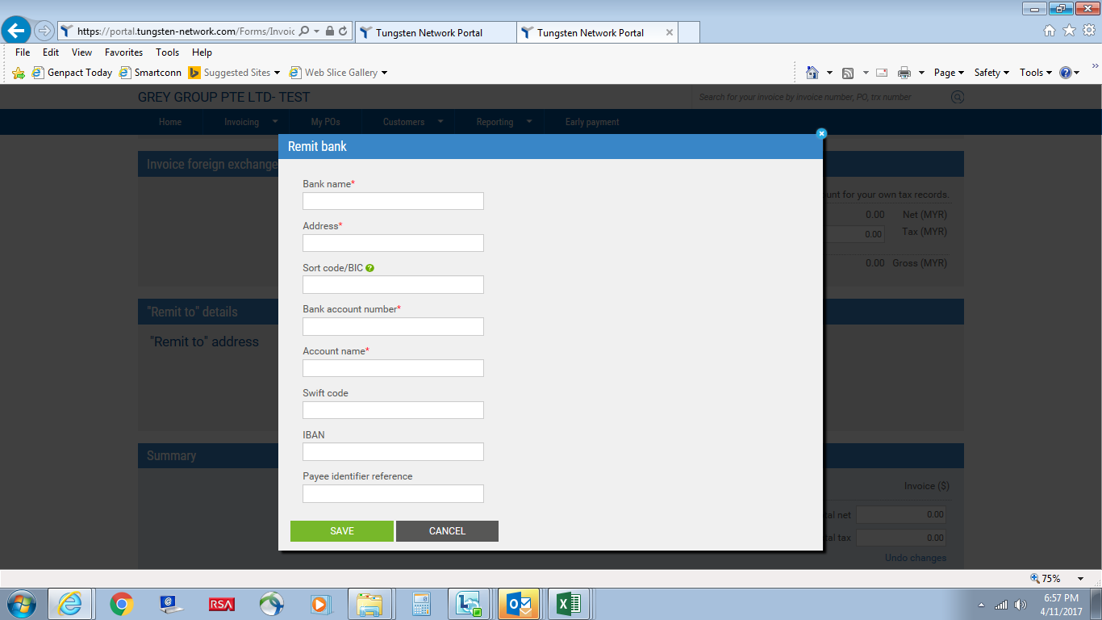
Update Bank details and click on ‘Save’

Slide 39
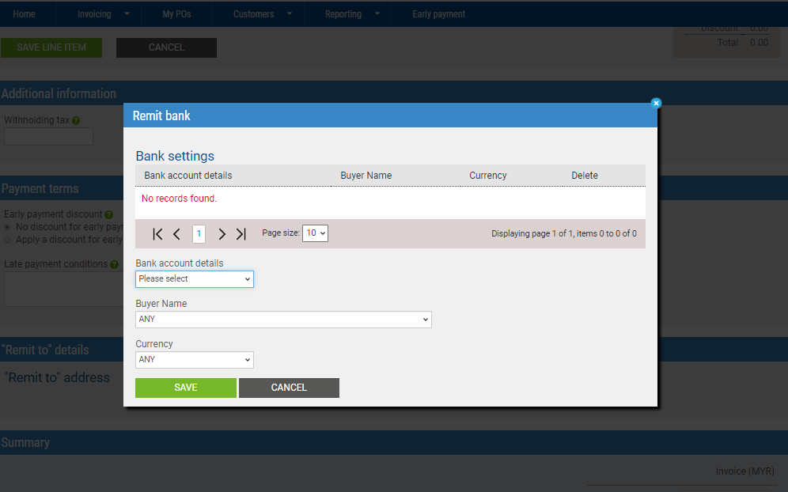
Select Bank account number of which this invoice will be paid to and ‘Save’
(Note: only those bank account number that have been added via steps described in slide 37 & 38 will be shown)

Slide 40
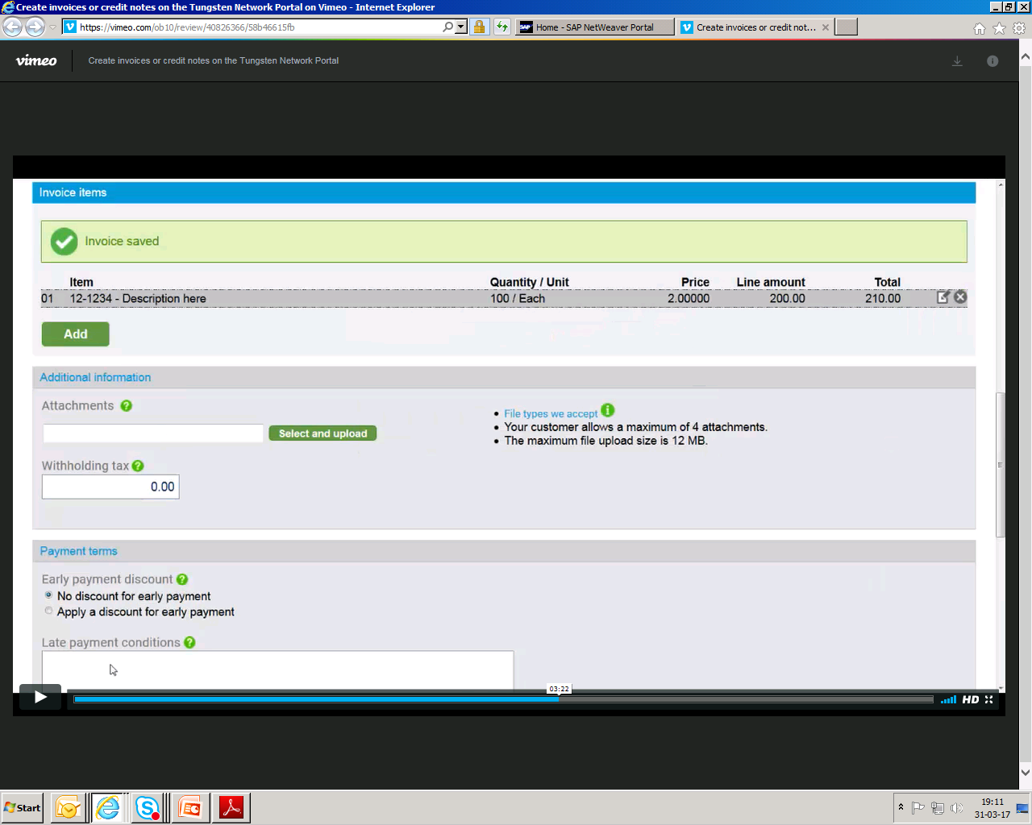
After clicking the save line item tab, the invoice line item will be saved. Process is now completed and invoice has been raised
IMPORTANT: Your E-invoice should be itemized as according to GSK PO line item

Slide 41
Support Contact Details

Slide 42
Tungsten Support Help Desk
Area where help is required | Who you should contact | How
Registering for e-invoicing | Tungsten | www.tungsten-network.com/support
Connecting to a new GSK entity | Tungsten | www.tungsten-network.com/support
Creating an e-invoice | Tungsten | www.tungsten-network.com/support
Submitting an e-invoice | Tungsten | www.tungsten-network.com/support
Using the Portal | Tungsten | www.tungsten-network.com/support
Invoice Status Service | Tungsten | www.tungsten-network.com/support
Missing POs on the Portal | Tungsten | www.tungsten-network.com/support
Invoice Approval | GSK | GSK supplier contact details
Invoice Payment | GSK | GSK supplier contact details

Slide 43
  End

