Slide 1

OMG Electronic Invoicing
Media Purchases
Guidelines to support timely payment to supplier invoices

Slide 2
CONTENTS
01.
Purpose of this document
Understand OMG’s requirements
02.
2.1 How do we buy from our suppliers?
2.2 How do we process supplier invoices?
2.3 Which OMG entity should I invoice?
Tips and tricks for fast invoice processing & payment
03.
3.1 Know booking reference
3.2 What if my invoice was rejected by Tungsten?
3.3 How do I check the status of my invoices?
3.4 What do the invoice statuses mean?
3.5 Where will I find payment details?

Slide 3
01
Purpose of
this document

Slide 4


PURPOSE OF THIS DOCUMENT
One of the many reasons why OMG have moved to the Tungsten Network e-Invoicing platform is to evolve and improve our existing financial practices, which will improve and expedite invoice processing and payment experience. However, OMG cannot make this improvement without the assistance from its suppliers. This guide provides our suppliers some guidelines to ensure that
Invoices successfully pass through the automated validation steps at Tungsten Network and reach OMG within minutes after you have created them.
Invoices contain all information required for fast processing and approval by OMG.
Suppliers know what to do with the information given to them regarding the status of their invoice(s).

Slide 5
02
Understand OMG’s
requirements

Slide 6
UNDERSTAND OMG’S REQUIREMENTS
2.1 How do we buy from our suppliers?
When OMG use our supplier services we provide our suppliers with a reference. There are a variety of references you may receive from us. However, all suppliers will receive one of our unique reference numbers in one of the below formats

Slide 7
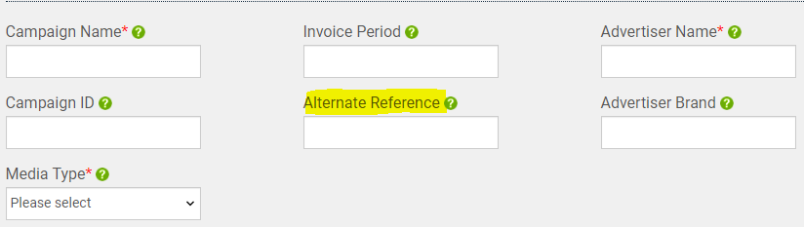
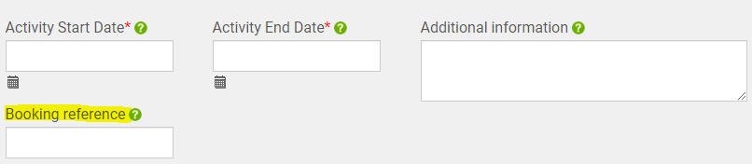

UNDERSTAND OMG’S REQUIREMENTS
All OMG entities use the above formats. Therefore, based on the first orders the supplier would be able to identify the booking reference that they require, to bill OMG.
All references boxed in blue in the table above should be populated in the ‘booking reference’ field. Either in the booking reference field in the portal (as highlighted below for web form suppliers), or in your flat file (Integration). The booking reference must be provided at line level. E.g. if your invoice has 5 line items, a booking reference must be provided per line.
All references boxed in orange in the table above should be populated in the alternative reference field. Either in the alternative reference field in the portal (as highlighted below for web form suppliers), or in your flat file (Integration). The alternative reference must be provided at header level. E.g. If you have 1 invoice with 5 line items you must use 1 alternative reference for the entire invoice.
There are exceptional cases where no booking reference is issued. However, for these cases the OMG contact who places the order should make you aware and advise where to submit your invoice.
Before creating the invoice, we ask our suppliers to make sure they receive/request a booking reference. Alternativity direct the invoice via the OMG contact that created the booking.
Note:
Please note booking references will continue to be submitted via the current booking platforms

Slide 8
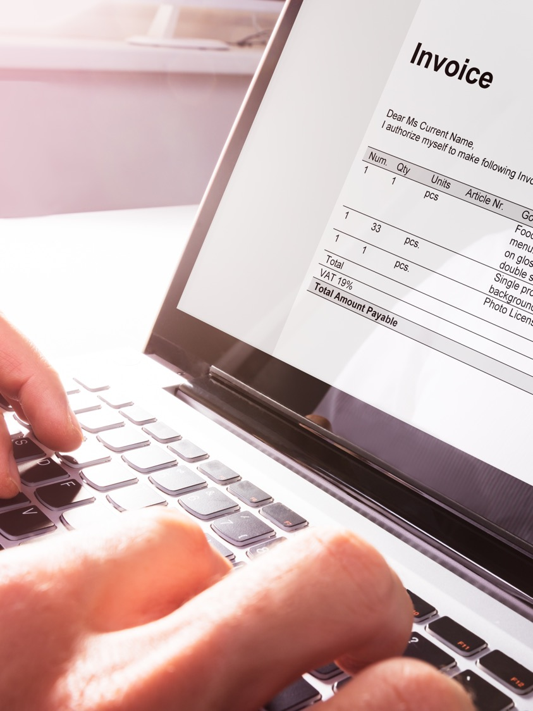
UNDERSTAND OMG’S REQUIREMENTS
2.2 How do we process supplier invoices?
Tungsten Network runs a series of validation steps on each
invoice submitted by our suppliers
This is to ensure that all information required is present
from a legal and tax perspective in the respective jurisdiction
when submitted to OMG for fast and efficient processing of your documents
The required fields are highlighted in the Tungsten Network web form (if you are using this for your invoice data input). However, there are certain validation steps which can only be performed once you have submitted the invoice. Therefore, please check the status of your invoices on a regular basis and resubmit any failed invoices/credits, once you have corrected the information which caused the failure.
Once we receive your invoice If your invoice is not 100%, therefore causing a query, it will be directed to an contact. The contact will review your invoice in query and work with you and the Buyer to bring the invoice to a satisfactory state.
When the invoice matches the booking reference 100% and your pay
due date has arrived, we will be able to release your invoice for payment.

Slide 9
UNDERSTAND OMG’S REQUIREMENTS
2.3 Which OMG entity should I invoice?
Media Payables
Entity Name | Tungsten AAA# | Address | VAT ID
OMG UK Media Group UK Limited | AAA059053041 | Bankside 2 & 3, 90-100 Southwark Street, London SE1 0SW | GB918213926
Resolution Media UK Limited | AAA251624045 | Bankside 2 & 3, 90-100 Southwark Street, London SE1 0SW | GB918213926
OMD Group Limited | AAA836774638 | Bankside 2 & 3, 90-100 Southwark Street, London SE1 0SW | GB918213926
Manning Gottlieb OMD | AAA386150940 | Bankside 2 & 3, 90-100 Southwark Street, London SE1 0SW | GB918213926
PHD Media Limited | AAA989620745 | Bankside 2 & 3, 90-100 Southwark Street, London SE1 0SW | GB918213926
Hearts and Science Limited | AAA422612382 | Bankside 2 & 3, 90-100 Southwark Street, London SE1 0SW | GB918213926
OMD EMEA Limited | AAA723110516 | Bankside 2 & 3, 90-100 Southwark Street, London SE1 0SW | GB266893939
PHD International Limited | AAA888890720 | Bankside 2 & 3, 90-100 Southwark Street, London SE1 0SW | GB266893939
Hearts & Science EMEA Limited (Media) | AAA614783942 | Bankside 2 & 3, 90-100 Southwark Street, London SE1 0SW | GB435029707
PHD Media (Ireland) Ltd | AAA574766226 | 1 Richview Office Park, Clonskeagh, Dublin 14
Optimum Media Direction (Ireland) Ltd | AAA347547614 | 1 Richview Office Park, Clonskeagh, Dublin 14
If your entity does not appear in the list shown here, there is a possibility it is a subsidiary. Here are alternative names you may recognise (in the blue boxes), and which you should invoice (in the header of the column).
For example, if the documentation you receive containing your booking reference does not have the name OMG, but it has one of the names below (e.g. OMD UK) you would invoice OMD Group limited
Please note that OMD EMEA Limited and PHD International Limited are separate legal and tax entities from OMD Group Limited and PHD Media Limited
OMD GROUP LIMITED
PHD MEDIA LIMITED
LONDON
UK
MANCHESTER

Slide 10
03
Tips and tricks for
fast invoice processing
and payment

Slide 11
Booking reference: All medias have a booking reference, also referred to as the serial number. These are provided at line level on the campaign.
TIPS AND TRICKS
DO NOT = LATE PAYMENT
DO = TIMELY PAYMENT
3.1 Know your booking reference
More than one letter prefix.
More than/less than 8 digits
1 letter followed by 8 digits
PO29443
P13934713
Please make sure you receive a booking reference for every OMG order and that you use it when billing an OMG entity.
Following the rules shown here will allow your invoice to pass through all validation and matching steps in a timely manner. It will also allow your invoice to avoid rejection and rework, and will enable us to pay you on time:
More/less than 8 digits
Without a letter prefix
8 digits only. Zeros included
T00157948
223112079
1 booking reference per line item
Provide more/less than 5 digits
More than one media in one
invoice (e.g. P&D)
X00274611
W00274611 & P13934713
One media type per invoice
R15489883
Combined booking references
W00274611/12
Booking reference (line level reference)
Not alternative reference (header level reference)
Alternative reference in the booking reference field
M12378460
O-124KB

Slide 12
Alternative Reference: Not all medias have a billable alternative reference. This only applies to Television (Caria), Radio (Jet/JCN) and Digital
(IO Confirmation #/Placement ID)
TIPS AND TRICKS
DO NOT = LATE PAYMENT
DO = TIMELY PAYMENT
CARIA
CARIA
Invalid character. Caria should be numbers only
C134127
123456
6 digits only
In order to be sure that your invoice was received by OMG please check its status in the dedicated portal section (learn how to use this functionality by clicking on the following link:
https://www.tungsten-network.com/video/check-your-invoice-status/
JCN
JCN
This is a booking reference not an alternative reference
7 digits only. Also known as the J-ET reference
R00273481
1234567
PLACEMENT ID
PLACEMENT ID
All placement IDs should have a P prefix
P followed by 5 alpha numerical characters
RDPM57
PZPB12
IO CONFIRMATION #
IO CONFIRMATION #
The revision number (-R0) should not be present
O – followed by 5 alpha number charachers
O-124KB-R0
O-124KB-R0

Slide 13

TIPS AND TRICKS
3.2 What if my invoice was rejected by Tungsten?
You can reactivate invoices that have the status ‘Failed’. You can do this by navigating to the ‘Invoice status’ page under the ‘Invoicing’ menu (the same menu that lists the ‘Create invoice’ page). Choose a failed invoice or credit note from the list and select the ‘View details’ icon. Select ‘REACTIVATE INVOICE’.
If you are having issues submitting an invoice you can raise a support ticket by following the steps below:
1. Log in to your Tungsten portal account
2. Go to Help & Support section
3. Click on “Open a support ticket”

Slide 14


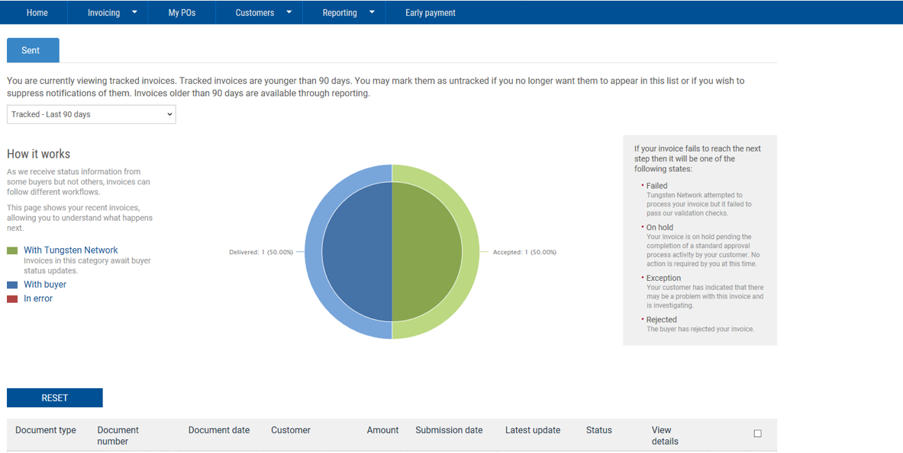
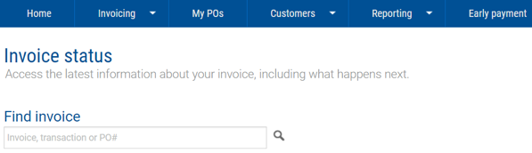
3.3. How do I check the status of my invoices?
TIPS AND TRICKS
E.G. Review Dashboard
As a member of the Tungsten network you will have access to view the status of your invoice(s) via the Tungsten portal. Invoice Status gives you the ability to view the status of your invoices individually or as an overview.
E.G. Search for your invoice number
For further detail view the video in
the following link.
https://www.tungsten-network.com/video/check-your-invoice-status/

Slide 15
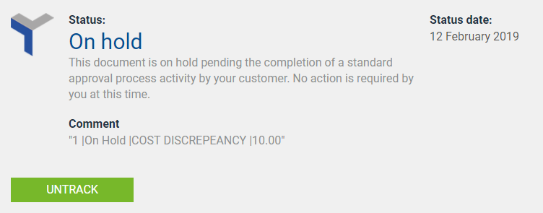
3.4 What do the invoice statuses mean?
TIPS AND TRICKS
Successful invoices will go from Accepted, Delivered to Paid status. However, any query invoices will end up in 1 of 4 statuses.
Failed: Tungsten Network attempted to process your invoice, but it failed to pass our validation checks.
On Hold: Your invoice is on hold pending the completion of a standard approval process activity by your customer. No action is required by you at this time.
In the comments section of the status you will find further detail as to why the invoice is in query. This comment will begin with the line item in your invoice, followed by the reason the specified line item is in query.
Rejected: The buyer has rejected your invoice.
Exception: OMG have indicated that there may be a problem with this invoice and is investigating.
This status is used to highlight to OMG’s suppliers that further attention is required from them. A comment will also be present. E.g. Credit note required.
Note:
When providing a credit note please quote the original invoice number and booking reference the credit note applies to.

Slide 16
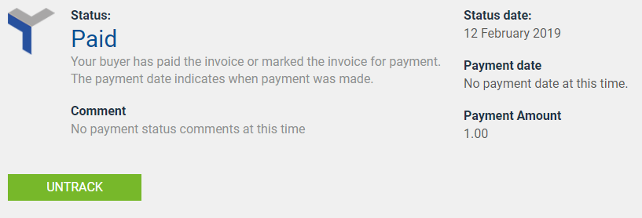
TIPS AND TRICKS
3.5 Where will I find payment details?
Payment and payment details will remain as part of the current processes that take place between the Supplier and OMG. However, the status of your invoice will change to paid on the Tungsten Network portal, once payment is made.
Note:
Your contact with OMG will remain as is. Tungsten will only display invoices that were submitted via Tungsten. If you have existing outstanding invoices with OMG please contact your contact for the status of your invoice(s).

